Slide 1
Share Ideas Lync: click to call and collaborate
Pawel Grzywaczewski IT/OIS
October 2014

Slide 2
Copyright: Alan Chapman, http://www.businessballs.com

Slide 3
Overview
Lync general features
Strengthen the collaboration
Demo
Lync phone features
New ways of calling
Demo

Slide 4
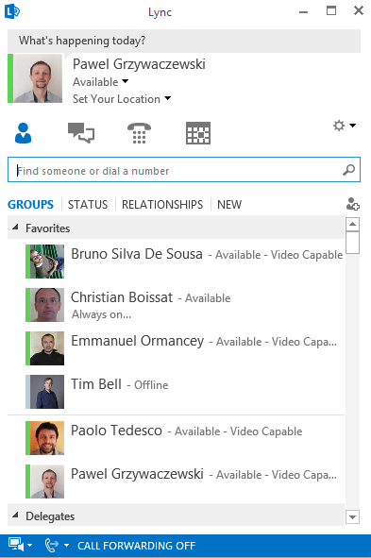
Lync

Slide 5
Collaboration - Advantages of using Lync
Softphone benefits
CERN Phone book,
Contacts in Exchange
List of contacts
Presence
Presence indicator
Clear message
Instant messaging
Phone calls from abroad (no roaming charges)
Wifi

Slide 6
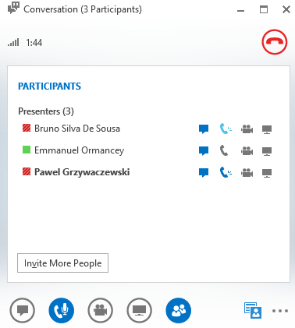
Possible use case
Start with E-mail (asynchronous communication)
Presence -> Go for instant communication
Add audio on Lync = phone/audio calls
Lync + audio + sharing = online meetings

Slide 7
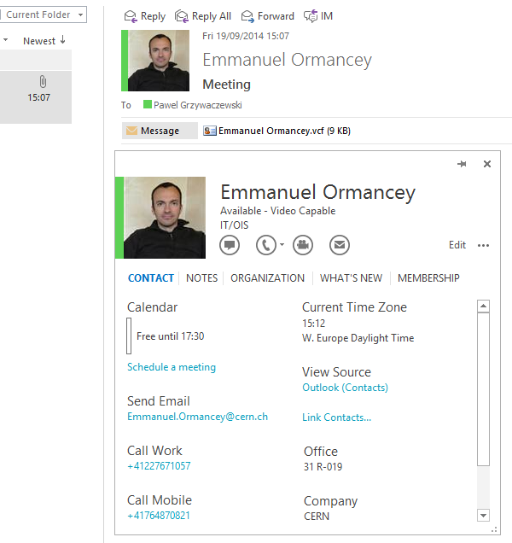
Integration: Outlook
Act from Outlook (phone, office, free/busy)
Take an action – based on status of others

Slide 8
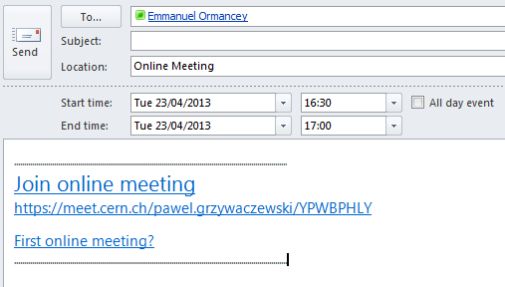
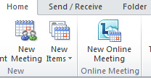
Increase productivity: Outlook
Create online meeting in Outlook
Small meetings, 5 – 10 attendants
Participants click on link and join
Desktop/application sharing
Audio/Video
Add easily new participants
“Meet Now“ – directly from Lync

Slide 9
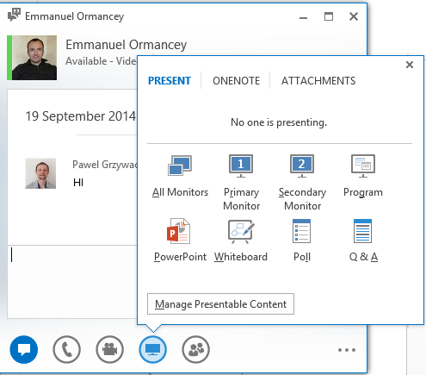
Sharing information
Click “Share” icon
Desktop.
A program (Word, Excel, Internet Explorer…)
Whiteboard
Create a poll

Slide 10
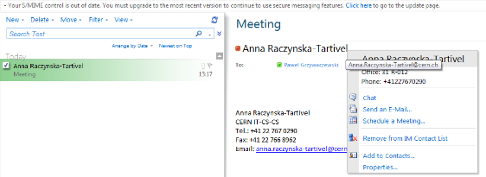
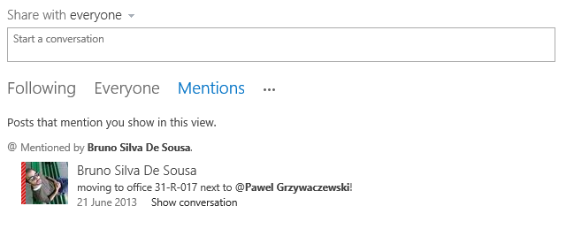
Integration with other tools
Webmail (OWA), https://mmm.cern.ch/owa
SharePoint
Vidyo plugin for Lync

Slide 11
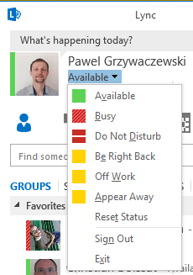
Manage presence in Lync
Available, Busy, Away, Do not disturb …
You decide who and what can see
By default people don’t see your status
Add them to contacts to show your status
Status is synchronized with your calendar
Out of office, events etc.
Set your status manually
Define “Relationship” of your contacts
“Workgroup” - will be able to bypass “Do not disturb” mode

Slide 12
One tool – several characteristics
Supports the collaboration
Efficient
Productive
Manage your time (based on your presence)
One tool for different actions

Slide 13
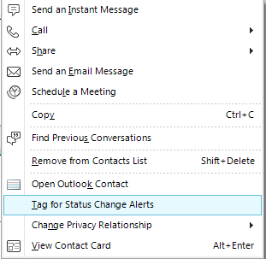
Manage presence in Lync
Busy status, means
He has an appointment in calendar
Or, he put the status manually
Do Not Disturb status, means
The status was chosen manually
No pop-ups (IM, calls, etc)
“Workgroup” will bypass
Tag your colleague
for status change

Slide 14
Demo

Slide 15
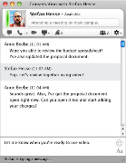
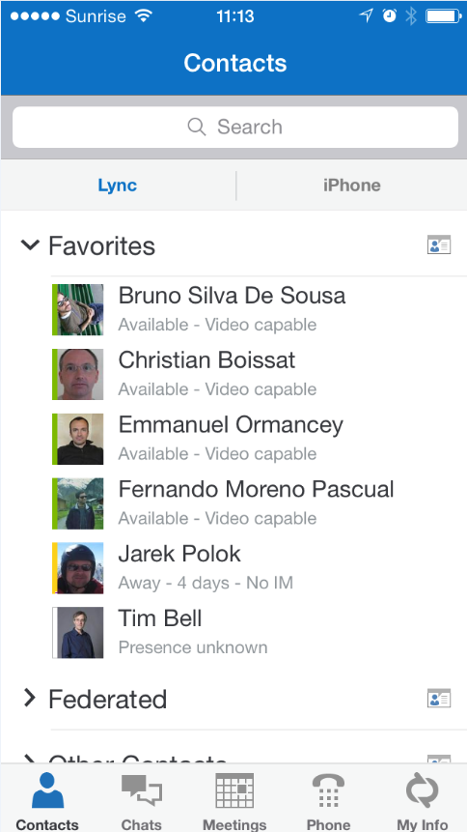
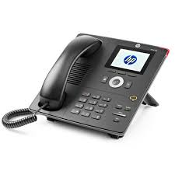
Lync clients
Lync 2010/2013 on Windows
Lync on MAC
Lync on smartphones
Lync IP Phone
Pidgin (Linux client)

Slide 16
Lync Phone system
What does it mean?
CERN landline (fixed) number on Lync
Somebody calls my CERN number: 77163
It will ring an Lync clients
Lync application (Windows/Mac, smartphones)
Lync IP Phone
I use my CERN phone number to place calls
Lync application (Windows/Mac, smartphones)
Lync IP Phones

Slide 17
Activation on Lync Phone system
Submit a “Phone request” on edh.cern.ch
Your phone number will be migrated to Lync Phone system
Use Lync clients to place phone calls
Not compatible with Alcatel IP Phones

Slide 18
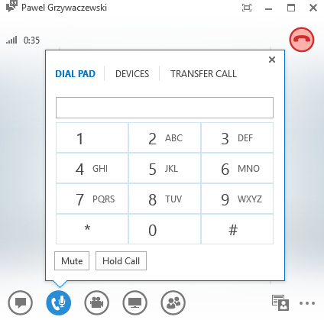
Lync application
Call your contacts with a single click
Search for CERN people (and your contacts)
If you have an external number, just paste it and press “Call”.
You can easily:
Put on hold (“pause” icon)
Forward to another number
Initiate a new call
Change the device (headset, etc.)

Slide 19
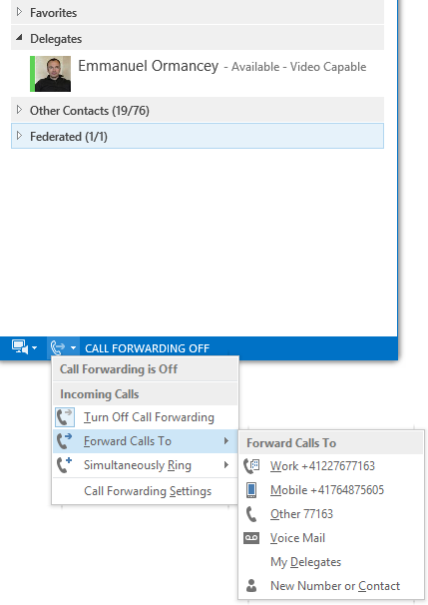
Forwarding calls
Other options are:
Forwarding to the voice mail.
To our delegates.
To any CERN number

Slide 20
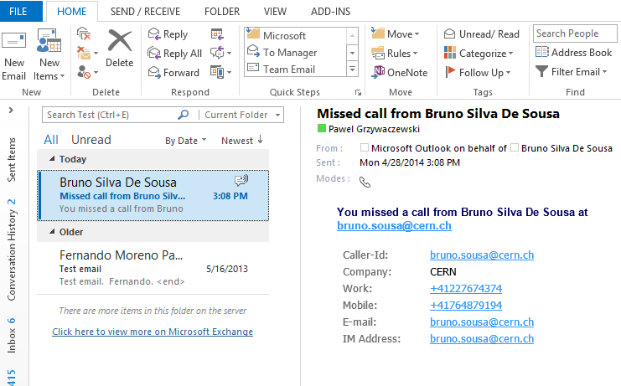
Voice mailbox & missed-calls
Lync is not running, or a person left a message on your voice mailbox:
Voice message forwarded to your inbox.
Missed incoming calls (busy, away, out of office…)
Notifications to your inbox about missed calls.
In the missed call notification we have:
All the information of the caller.
The time when the call was made.

Slide 21
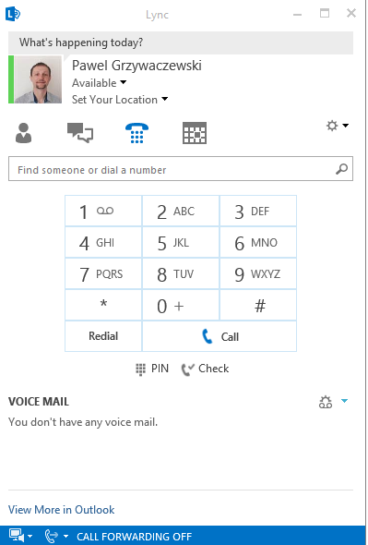
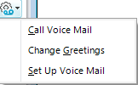
Voice mailbox
Access from Lync
Change greetings
Set up voice mail
Access/configure from a standard phone
Call: (+412276)71111
Use your PIN
Received during activation
Can be reset from Webmail
17

Slide 22
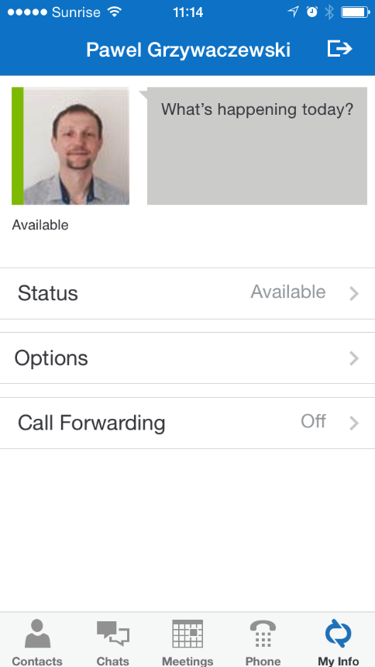
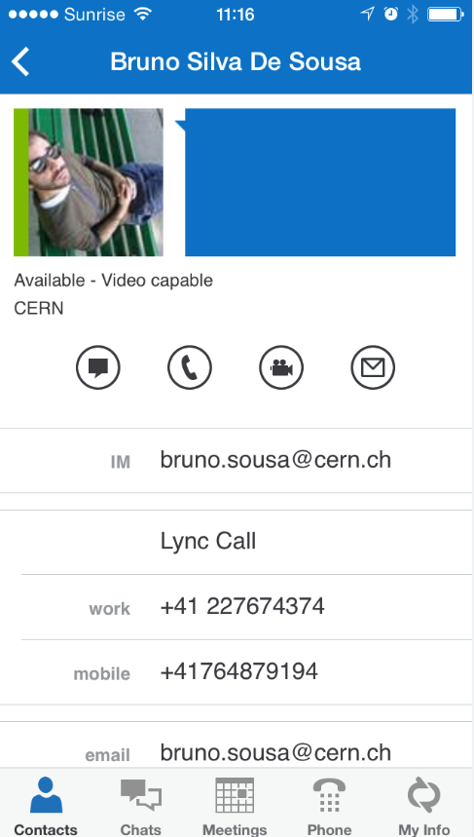
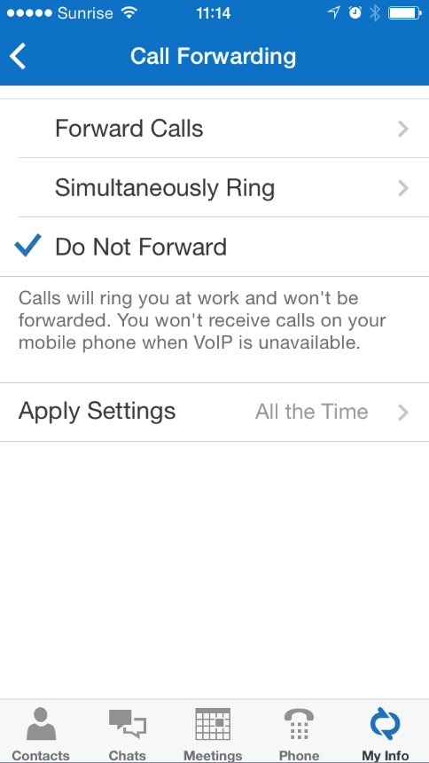
Lync on smartphones

Slide 23
Lync IP Phones
Recommended for new installation
Similar to current IP phones + advantages
Softphone features (on Mac and Windows)
Use your CERN phone number from anywhere (home, conference, hotel etc.)
Easy management of phone settings and forwarding
Voice messages received as an e-mail into Inbox
Devices available in CERN Store

Slide 24
Demo

Slide 25
Start using it …
All CERN people have Lync account
Instant Messaging, presence etc.
Lync on Windows/Mac, and Pidgin in Linux
Add photo to Lync/mail system on http://social.cern.ch
Lync Phone
Save costs on roaming
Collaborate from any place around the world
Communicate with external contacts
Other companies/institutes having Lync (federation needed)
Gtalk
Skype (Microsoft Live account needed)

Slide 26
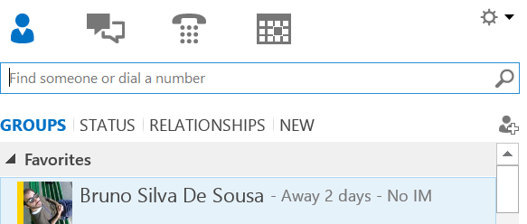
Lync to Skype
Person on Skype logs in using “Microsoft Live ID”
Person on Lync sends an invitation
Click Add Contact
Choose “Skype”
Provide sip address
login_name@domain.com
Person on Skype accepts the invitation
Contact from Lync to Skype and vice versa
Instant messaging
Presence
Audio calls

Slide 27
Summary
Lync, https://cern.ch/lync
Find the best approach for your working environment
Share your thoughts on social https://cern.ch/lync-community
Lync provides you:
Different ways to collaborate
Easy way to make phone calls
Easy way to configure forwarding
No roaming charges - Use your CERN number from anywhere (hotel, home etc.)
Voice mail on your e-mail client
Support: contact service-desk@cern.ch

Slide 28
Thank you for your attention
Questions?

