Slide 1
Training for Guides in Computer Centre CERN Open Days 2013
20th September 2013
IT Volunteer Coordination: Andreas Wagner, Pawel Grzywaczewski

Slide 2
Training for Guides in Computer Centre
Outline
Introduction
CC Tours – Visitors Flow
Guiding a group through the CC
Computer Centre - facts and figures
Questions

Slide 3
Introduction
Computer Centre Guides for Open Days:
as of 20.09.2013: 87 CC Guides total!
CC Guides - Training Itinerary:
Today’s training session
Will be recorded and made available
Next week, 5 sessions ‘Hands-on’; please sign-up!
Material
‘cheat-sheet’ with key info and numbers about CC
https://information-technology.web.cern.ch/staff/openday-2013
Thank you for volunteering!

Slide 4
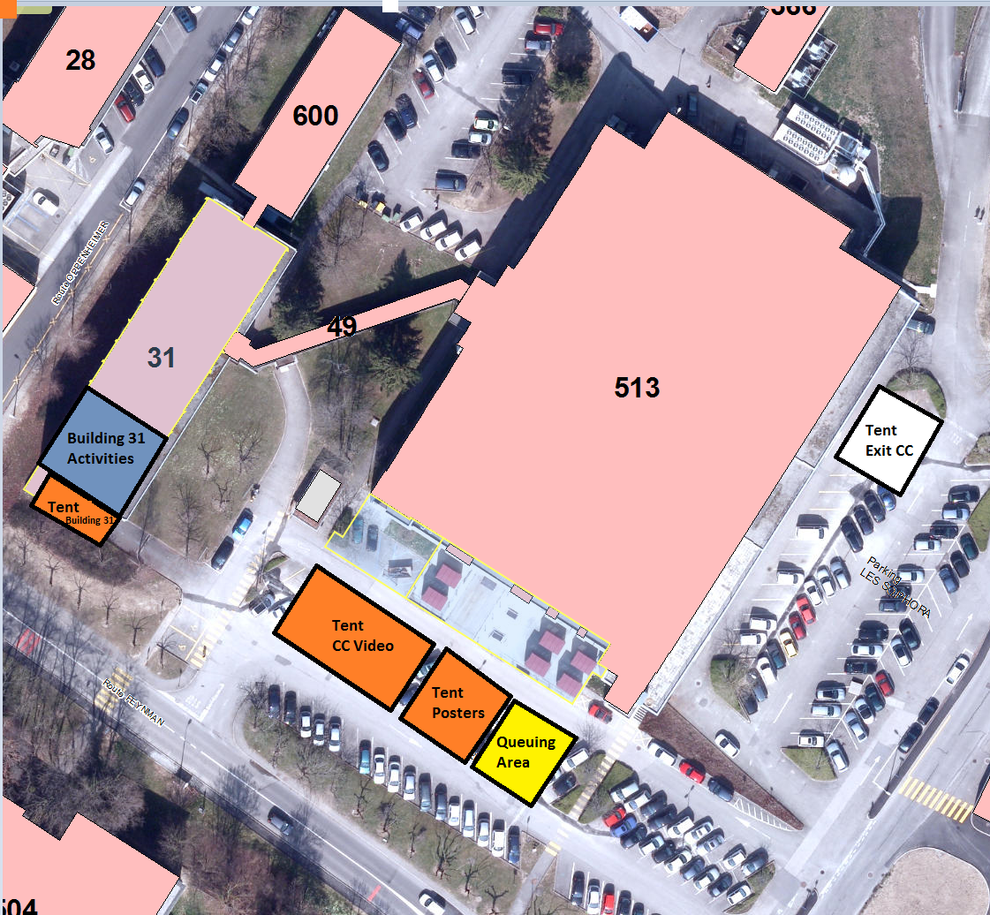
IT Visit Point and Activities
Site Manager: Vincent Dore

Slide 5
Welcome & Video Tent

Slide 6
Open Days CC Video
Video for the Open Days about IT
7 minutes’ video, 3 parts:
How computing evolved at CERN (from 1954 till now)
The role of the IT department
The data centre
Text in English and French

Slide 7
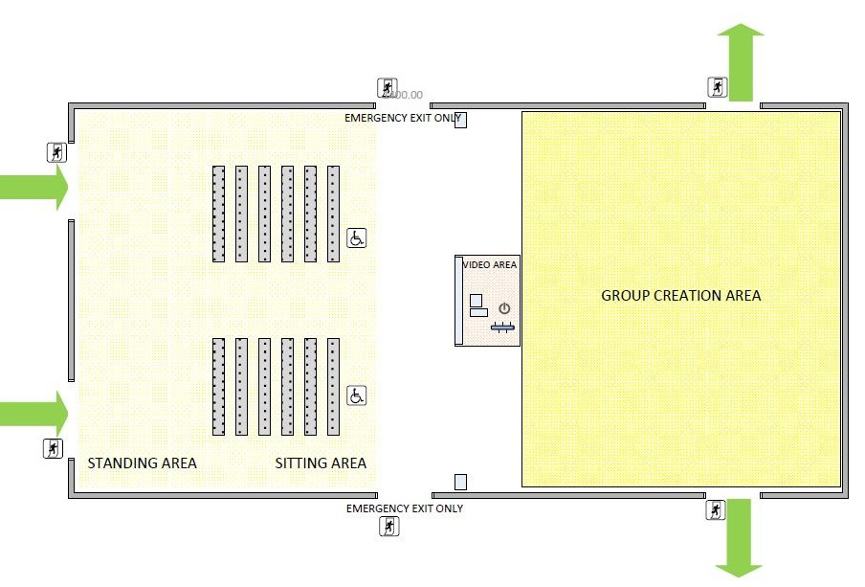
Welcome & Video Tent

Slide 8
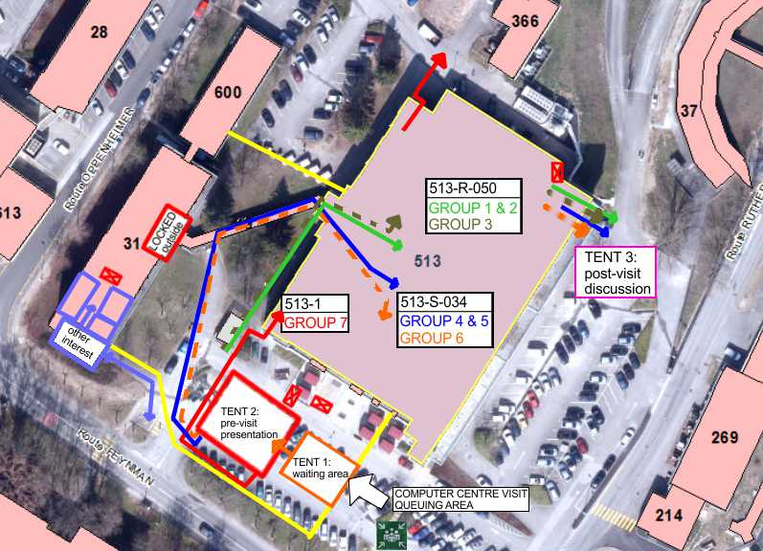
CC Tour – Visitors Flow

Slide 9
CC Tour – Visitors Flow
Visitors Flow - overview:
150 visitors / 15 minutes
divided into 7 groups, organised by language:
Group 1,2,3: CC tour R-050 (20 visitors per group)
Group 4,5,6: CC tour S-034 (20 visitors per group)
Group 7 (no en/fr): 513 1st floor (30 visitors)
2 guides per group:
guide 1 gives the tour
guide 2 is responsible for keeping the group together
In addition non-en/fr language experts on 1st floor of 513

Slide 10
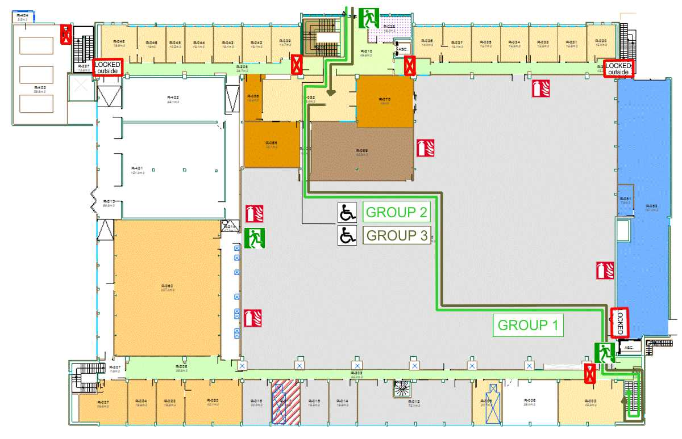
CC Tour – Groups 1,2,3
Visitors Flow (Main machine room 513-R-050):

Slide 11
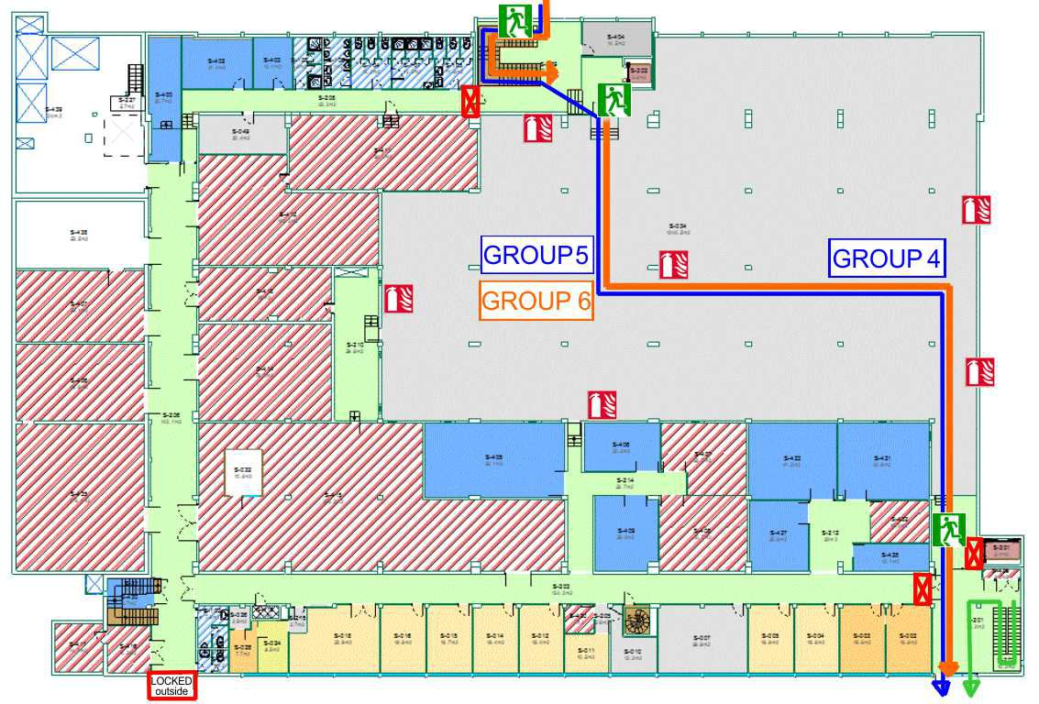
CC Tour – Groups 4,5,6
Visitors Flow (Vault 513-S-035):

Slide 12
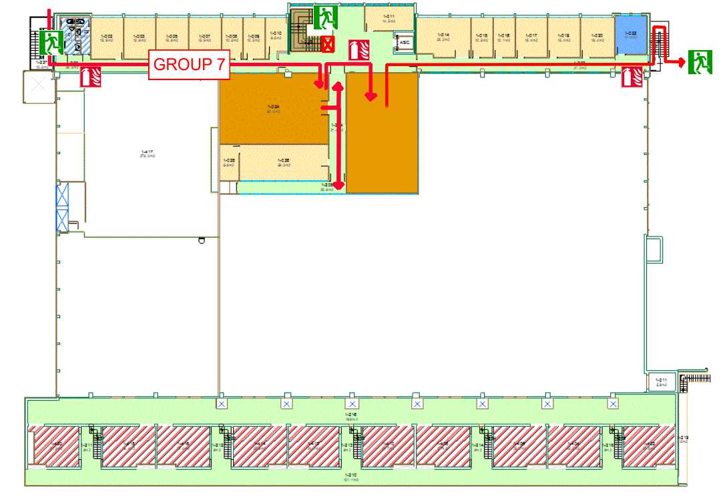
CC Tour – Group 7
Visitors Flow (513 first floor):

Slide 13
Guiding a group through the CC
Guiding a group
Two Guides per group
Guide 1:
gives the explanation
Guide 2:
Ensures group stays together
keeps the time
watches other groups
The main objective is to show the CC ⇨ you have only few minutes for explanations inside the machine rooms!
Stick to the time, questions after the visit in/around the exit tent (no more than 5 minutes)
Return timely to the video tent exit for the next tour

Slide 14
Guiding a group through the CC
Guiding a group - dos and don'ts
It will be very busy, so take care that groups don’t mix!
Guide 2 is always the last person when moving the group!
Do not try to overtake other groups!
If there are some problems with a group, be firm but polite, and feel free to end the tour at any time and get help if necessary!
If you do have a CERN GSM, please bring it along!
We will give you all relevant numbers of IT organisers
Guiding language
Default Guide Language
~Time | 513-R-050 | 513-S-035
9:00 – 12:00 | French | English
12:00 – 14:30 | English | French
14:30 – 17:30 | English | French
17:30 – 20:00 | French | English

Slide 15
Computer Centre - facts and figures (I)
Computing power
10,000 servers
90,000 processor cores
hosted in 3 CC rooms of 513
To cover CERN’s needs, since 2013 also CC extension in Wigner Research Centre for Physics in Hungary
Storage
LHC experiments produce over 25 Petabyte per year (1 PB = 1,000,000 GB) 25 PB equivalent 5 million DVDs, stacked would be tower of 6 km height
Total data stored at CERN: 100 petabytes (~ 700 years of HD quality movies)
More than 480 million experiment files are stored in data centre
WLCG
More than 160 data centres
CERN provides about 15% of resources
Allows more than 10,000 physicists to access LHC data
250,000 jobs run concurrently on the Grid

Slide 16
Computer Centre - facts and figures (II)
Networking
35,000 km of optical fibre needed to transfer large amount of LHC data to and from CC
Two 100 Gigabit per second circuits connect CC and Wigner data centre (the first international 100 Gb/s circuits in production worldwide)
Each day equivalent of 210,000 DVDs of data processed
Capacity of 4000 simultaneous Wi-Fi connections (6000 devices connected every day)
Electricity
3.5 megawatt max computing power consumption
CC protected by UPS (Uninterruptable Power Supply)
Allows to start diesel generators for critical systems
Provide time to shut down non-critical systems
Cooling
Main Machine room, chilled air via blue ducts, into false floor and then into closed server aisles
Vault also water cooled racks (higher cooling capacity per rack)
Cold air temperature 14-21 ºC

Slide 17
Time Slots - Reminder
CERN Open Days IT Volunteers:
Open Days for public: Saturday & Sunday 9:00 – 20:00
For IT volunteers:
Saturday
Morning: 8:00 - 15:00
Afternoon 14:00 - 21:00
Sunday
Morning: 8:00 - 15:00
Afternoon 14:00 - 21:00
Handover of activities: ~14:30
Note: We are still in process to recruiting additional IT volunteers in order to allow for some breaks during your shifts!

Slide 18
And …
Don’t forget to sign up for ‘Hand-On’ Training Sessions
This presentation and further relevant information will be made available on the IT Open Days Volunteer pages: https://information-technology.web.cern.ch/staff/openday-2013
Please do follow the SIR “Open Days” module: http://sir.cern.ch
Thank you for volunteering to make the Open Days 2013 a great event for IT and for CERN!

Slide 19
Questions
Questions ?

